Slide 1
BITS Pilani presentation
K. Venkata Ratnam
Mathematics

Slide 2
Course Number : SS ZC416
Course Title: MATHEMATICAL FOUNDATIONS
FOR DATA SCIENCE
Lecture No. :1

Slide 3
Erwin Kreyszig, Advanced Engineering Mathematics, Wiley India, 9 th Edition.
M1 | 1. Matrices, System of equations, determinants and inverse of a matrix 1.1. Matrix Algebra-Row-reduced echelon form of a matrix, Inverse of a matrix 1.2. System of linear equations, Consistency and inconsistency of system of linear equations
M2 | Vector spaces and Linear transformations 2.1 Vector space, subspace and span of a set, Linear dependence and independence of a set of vectors, basis and dimension 2.2. Linear transformation, rank and nullity
M3 | 3. Eigenvalues and Eigenvectors 3.1. Eigenvalues 3.2. Eigenvectors

Slide 4
Erwin Kreyszig, Advanced Engineering Mathematics, Wiley India, 9 th Edition.
M4 | 4. Numerical linear algebra 4.1. Gauss elimination with partial pivoting and scaling 4.2. Iterative methods for solving linear system of equations
M5 | 5. Matrix Eigenvalue Problems 5.1. Eigenvalue problems in linear system of equations 5.2. Power method for finding the dominant eigenvalue

Slide 5
Kenneth H. Rosen, Discrete Mathematics and its Applications, Tata McGraw Hill, 7th Ed., 2011.
M6 | 6. Sets, Functions and Relations, Boolean Algebra 6.1 Introduction to set theory, set relations, set operators, cardinality of sets, Cartesian product of sets 6.2 Fundamentals of functions – range, domain, injection, surjection, bijection of functions 6.3 Fundamentals of relations, reflexive, symmetric and transitive properties in relations, representing relations, applications of relations, equivalence relations, partial order relations, lattices. 6.4 Boolean functions, representing Boolean functions
M7 | 7. Graph Theory 7.1 Introduction to graph theory, directed and undirected graphs, handshaking theorem, special graph structures, graph representations and isomorphism of graphs, connectedness, components, Euler, Hamilton paths and cycles 7.2 Trees, binary trees, binary search tree, spanning trees, minimum spanning trees – Prim’s and Kruskal’s algorithms.

Slide 6
Examinations
No | Name | Type | Duration | Weight | Day, Date, Session, Time
EC-1 | Quiz-I | Online | - | 5% | September 10-20, 2020
 | Quiz-II | Online |  | 5% | October 20-30, 2020
 | Quiz - III | Online |  | 5% | November 10-20, 2020
EC-2 | Mid-Semester Test | Closed Book | 2 hours | 35% | Sunday, 11/10/2020 (FN) 10 AM - 12 Noon
EC-3 | Comprehensive Exam | Open Book | 3 hours | 50% | Sunday, 13/12/2020 (FN) 9 AM – 12 Noon
Legend: EC = Evaluation Component; AN = After Noon Session; FN = Fore Noon Session

Slide 7
Todays Lecture
Matrices
Notations
Matrix Multiplication
Different Type of Matrices
Elementary Row Operations
Row Equivalent Systems
Row-Reduced Echelon Form of a Matrix

Slide 8
Matrix
A matrix is a rectangular array of numbers or functions which we will enclose in brackets. A= [a_{jk}] where j= 1…m, k=1,2,…,n.
The numbers (or functions) are called entries or, less commonly, elements of the matrix.
Square matrices, which means that each has as many rows as columns. (m=n)
Matrices having just a single row or column are called vectors just one row is called a row vector just one column and is called a column vector.
Linear Systems, a Major Application of Matrices.

Slide 9
Definitions:
General Matrix representation

Slide 10
Definitions

Slide 11
Definitions

Slide 12
Definitions

Slide 15
Prove that (AB)^{T}=B^{T}A^{T}

Slide 16

Every square matrix can be represented as sum of symmetric and skew symmetric matrices.
A=$\frac{1}{2}\left(A+A^{T}\right)+\frac{1}{2}(A−A^{T})$

Slide 17
Triangular Matrices
Upper triangular matrices are square matrices that can have nonzero entries only on and above the main diagonal, whereas any entry below the diagonal must be zero.
Similarly, lower triangular matrices can have nonzero entries only on and below the main diagonal. Any entry on the main diagonal of a triangular matrix may be zero or not.

Slide 18
Elementary Row Operations. Row-Equivalent Systems
Elementary Row Operations for Matrices:
Interchange of two rows
Addition of a constant multiple of one row to another row
Multiplication of a row by a nonzero constant c
CAUTION! These operations are for rows, not for columns!
Row-Equivalent Systems: Row-equivalent linear systems have the same set of solutions.
We now call a linear system S₁ row-equivalent to a linear system S₂ if S₁ can be obtained from S₂ by (finitely many!) row operations. (This justifies Gauss elimination ).

Slide 19
Row Echelon Form
Row echelon form: In it, rows of zeros, if present, are the last rows, and, in each nonzero row, the leftmost nonzero entry is farther to the right than in the previous row.

Slide 20
Rank
The number of nonzero rows, r, in the row-reduced coefficient matrix R is called the rank of R and also the rank of A.
A---------row operations----→ R ( no of non zeros rows )→ rank

Slide 21
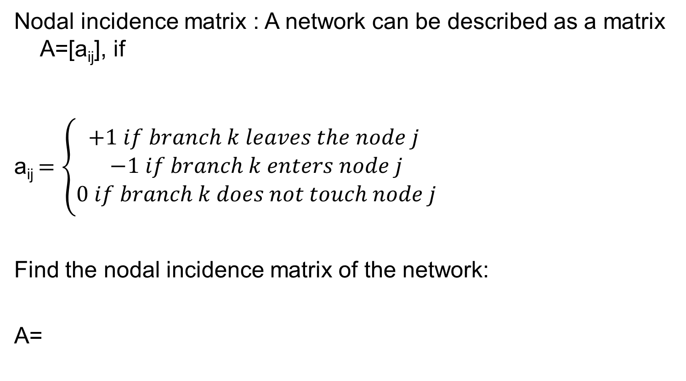
Problem-1 ( Graph as a matrix)
Nodal incidence matrix : A network can be described as a matrix A=[a_{ij}], if
a_{ij} $=\left\{\begin{aligned}+1 if branch k leaves the node j \\ −1 if branch k enters node j \\ 0 if branch k does not touch node j\end{aligned}\right.$
Find the nodal incidence matrix of the network:
A=
-1 1 0 -1 -1
-1 0 0 0
0 0 1 0 1

Slide 22
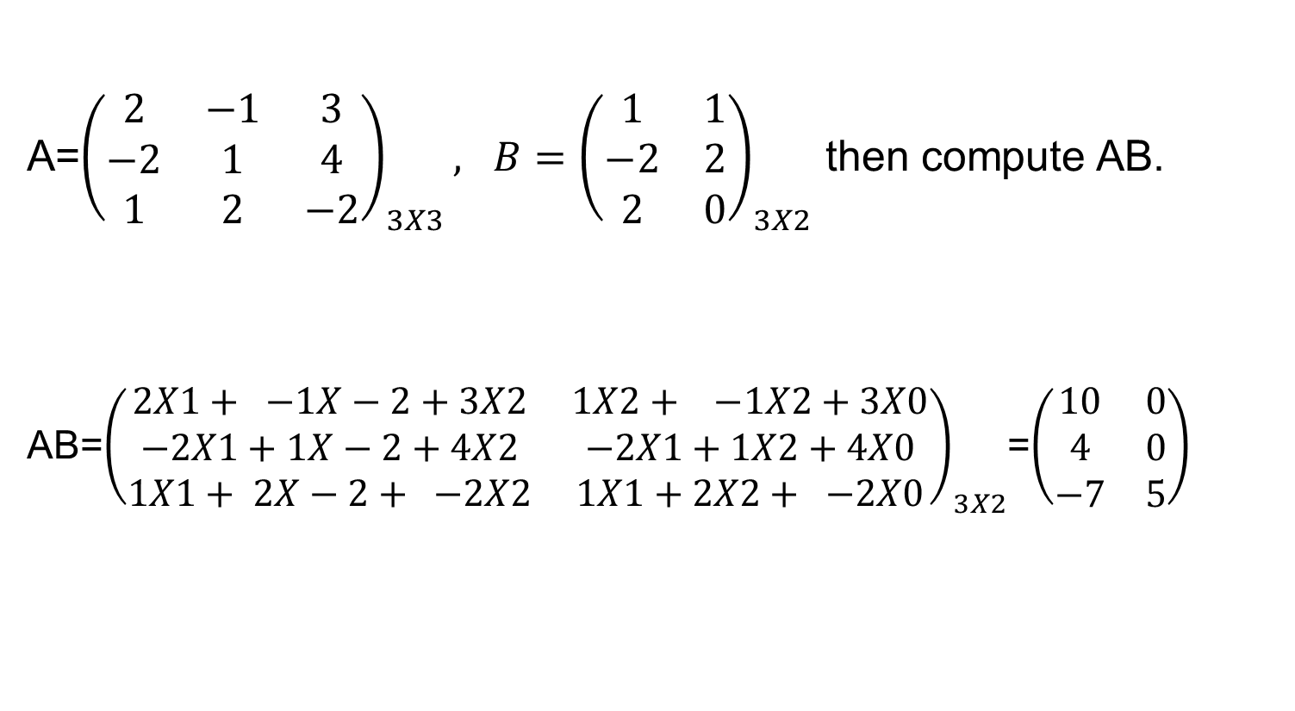
Problem-2 ( Matrix Multiplication)
A=${\left(\begin{matrix}2 & −1 & 3 \\ −2 & 1 & 4 \\ 1 & 2 & −2\end{matrix}\right)}_{3X3}, B={\left(\begin{matrix}1 & 1 \\ −2 & 2 \\ 2 & 0\end{matrix}\right)}_{3X2}$ then compute AB.
AB=${\left(\begin{matrix}2X1+ −1X−2+3X2 & 1X2+ −1X2+3X0 \\ −2X1+1X−2+4X2 & −2X1+1X2+4X0 \\ 1X1+ 2X−2+ −2X2 & 1X1+2X2+ −2X0\end{matrix}\right)}_{3X2}$=$\left(\begin{matrix}10 & 0 \\ 4 & 0 \\ −7 & 5\end{matrix}\right)$

Slide 23
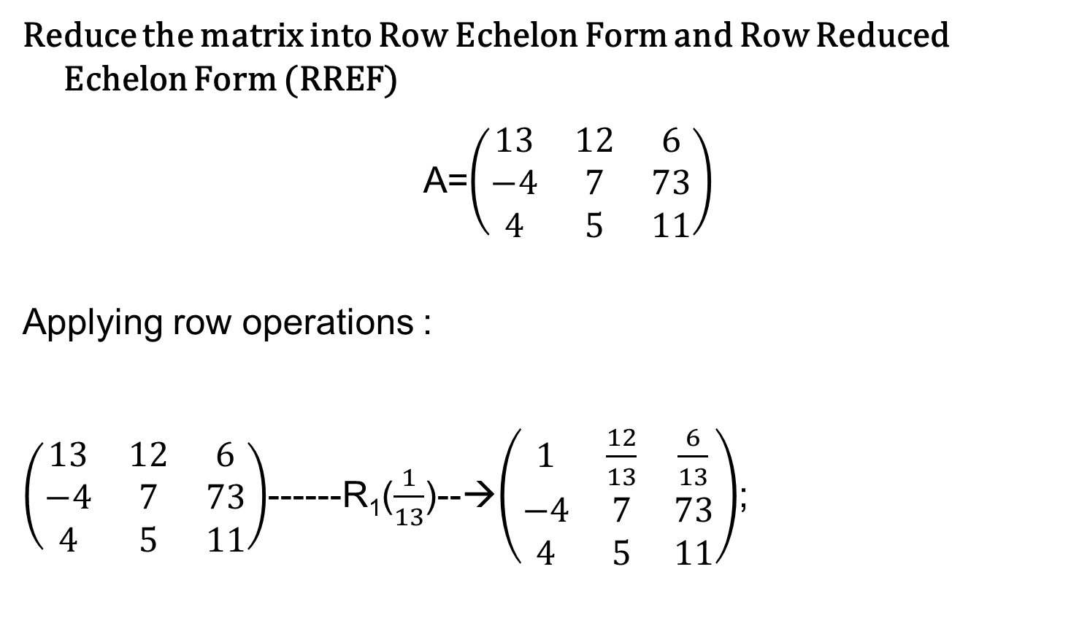
Problem -3
(Row Echelon Form)
Reduce the matrix into Row Echelon Form and Row Reduced Echelon Form (RREF)
A=$\left(\begin{matrix}13 & 12 & 6 \\ −4 & 7 & 73 \\ 4 & 5 & 11\end{matrix}\right)$
Applying row operations :
$\left(\begin{matrix}13 & 12 & 6 \\ −4 & 7 & 73 \\ 4 & 5 & 11\end{matrix}\right)$------R₁($\frac{1}{13}$)--→$\left(\begin{matrix}1 & \frac{12}{13} & \frac{6}{13} \\ −4 & 7 & 73 \\ 4 & 5 & 11\end{matrix}\right)$;

Slide 24
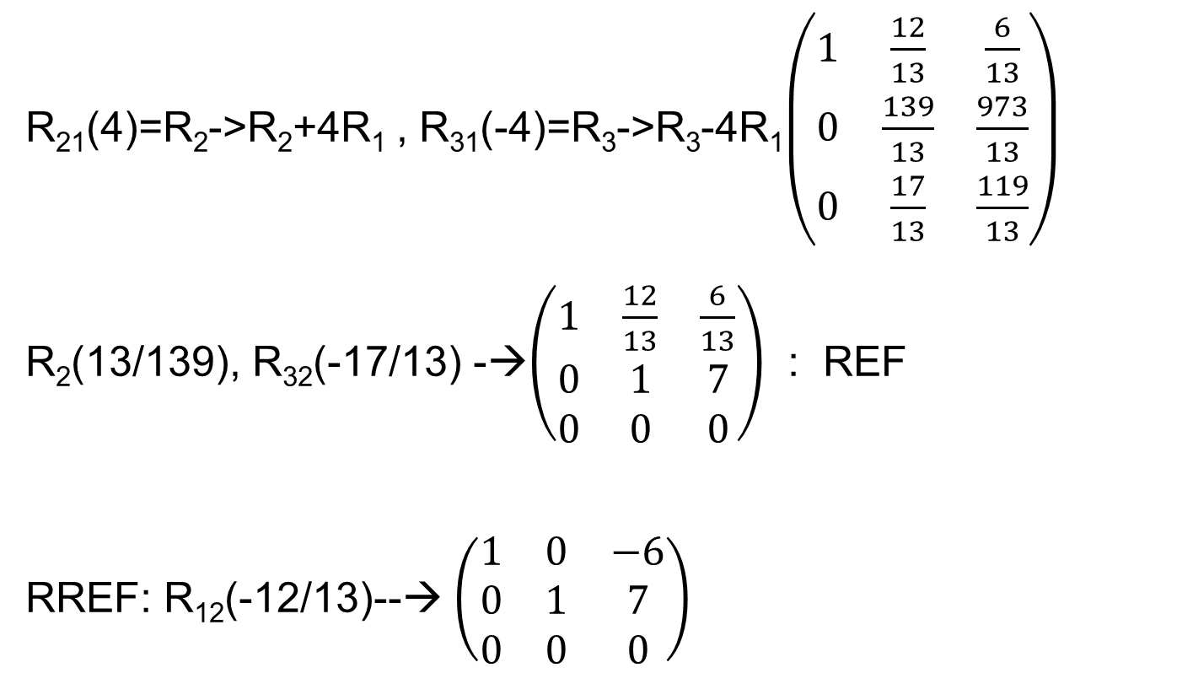
Cont…
R₂₁(4)=R₂->R₂+4R₁ , R₃₁(-4)=R₃->R₃-4R₁$\left(\begin{matrix}1 & \frac{12}{13} & \frac{6}{13} \\ 0 & \frac{139}{13} & \frac{973}{13} \\ 0 & \frac{17}{13} & \frac{119}{13}\end{matrix}\right)$
R₂(13/139), R₃₂(-17/13) -→$\left(\begin{matrix}1 & \frac{12}{13} & \frac{6}{13} \\ 0 & 1 & 7 \\ 0 & 0 & 0\end{matrix}\right)$ : REF
RREF: R₁₂(-12/13)--→ $\left(\begin{matrix}1 & 0 & −6 \\ 0 & 1 & 7 \\ 0 & 0 & 0\end{matrix}\right)$

Slide 25

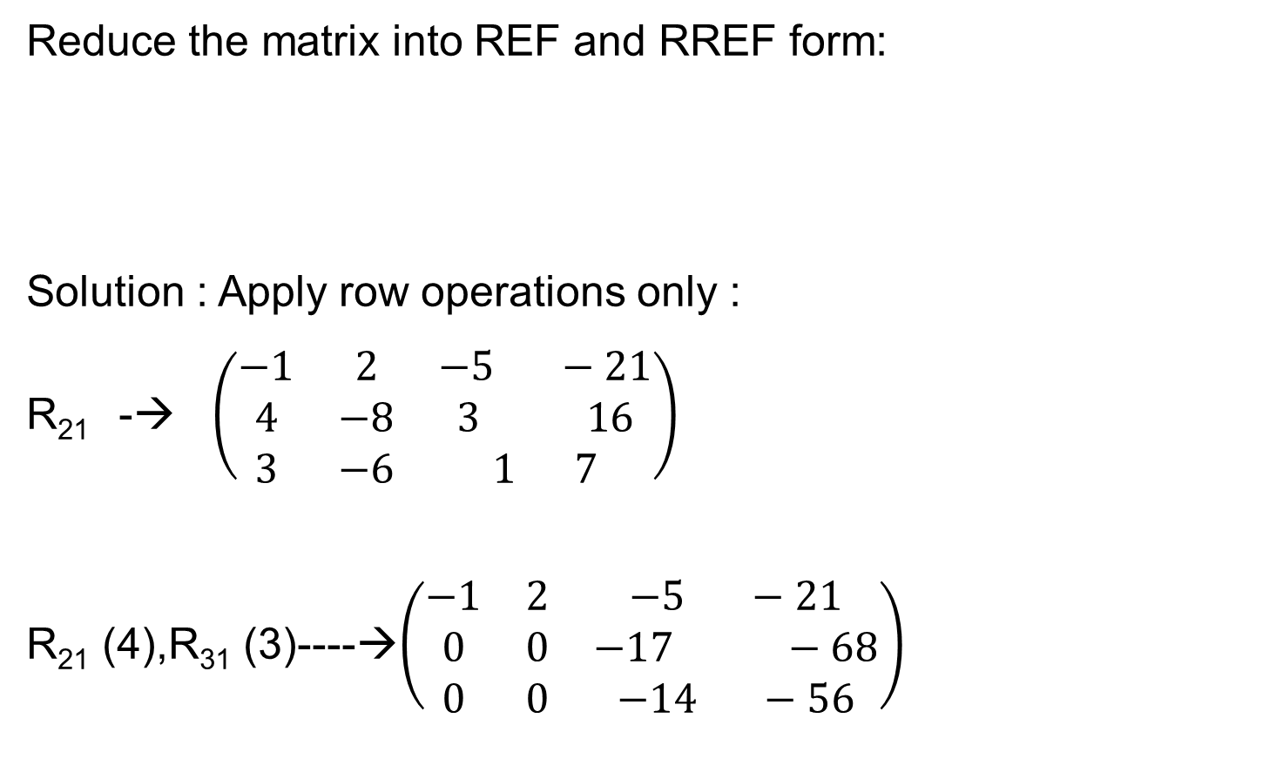
Problem-4
Reduce the matrix into REF and RREF form:
Solution : Apply row operations only :
R₂₁ -→ $\left(\begin{matrix}−1 & 2 & −5 −21 \\ 4 & −8 & 3 16 \\ 3 & −6 & 1 7\end{matrix}\right)$
R₂₁ (4),R₃₁ (3)----→$\left(\begin{matrix}−1 & 2 & −5 −21 \\ 0 & 0 & −17 −68 \\ 0 & 0 & −14 −56\end{matrix}\right)$
$$\left(\begin{matrix}4 & −8 & 3 16 \\ −1 & 2 & −5 −21 \\ 3 & −6 & 1 7\end{matrix}\right)$$

Slide 26

R₂(-1/17), R₃(-1/14)---→$\left(\begin{matrix}−1 & 2 & −5 −21 \\ 0 & 0 & 1 4 \\ 0 & 0 & 1 4\end{matrix}\right)$
R₃₂(-1)---→$\left(\begin{matrix}−1 & 2 & −5 −21 \\ 0 & 0 & 1 4 \\ 0 & 0 & 0 0\end{matrix}\right)$
R₁₂(5)----→ $\left(\begin{matrix}1 & 2 & 0 −1 \\ 0 & 0 & 1 4 \\ 0 & 0 & 0 0\end{matrix}\right)$-----→RREF

Slide 27
Problem-5
What form does 3X3 matrix have if it is symmetric as well as skew symmetric?
Idempotent matrix : A²=A, find 2X2 idempotent matrix
Nilpotent Matrix : A^{n} =0 for some n, give an example of that using 2X2 matrix

Slide 28

Solution:
Zero Matrix only satisfies this criteria.
$\left(\begin{matrix}1 & 0 \\ 0 & 1\end{matrix}\right)$ $\left(\begin{matrix}1 & 0 \\ 0 & 0\end{matrix}\right)$
$\left(\begin{matrix}2 & 2 \\ −2 & −2\end{matrix}\right)$ $\left(\begin{matrix}0 & 0 \\ 1 & 0\end{matrix}\right)$

Slide 29

Problem
Reduce the matrix into RREF:
$$\left(\begin{matrix}2 & 3 & 1 \\ 5 & −2 & 5 \\ \begin{aligned}1 \\ 3\end{aligned} & \begin{aligned}−1 \\ 4\end{aligned} & \begin{aligned}3 \\ −7\end{aligned}\end{matrix} \begin{matrix}−11 \\ −4 \\ \begin{aligned}−3 \\ 2\end{aligned}\end{matrix} \begin{matrix}1 \\ 5 \\ \begin{aligned}3 \\ −7\end{aligned}\end{matrix}\right)$$
Solution :
1 | 0 | 0 | 0 | 0
0 | 1 | 0 | -3 | 0
0 | 0 | 1 | -2 | 1
0 | 0 | 0 | 0 | 0

Slide 30
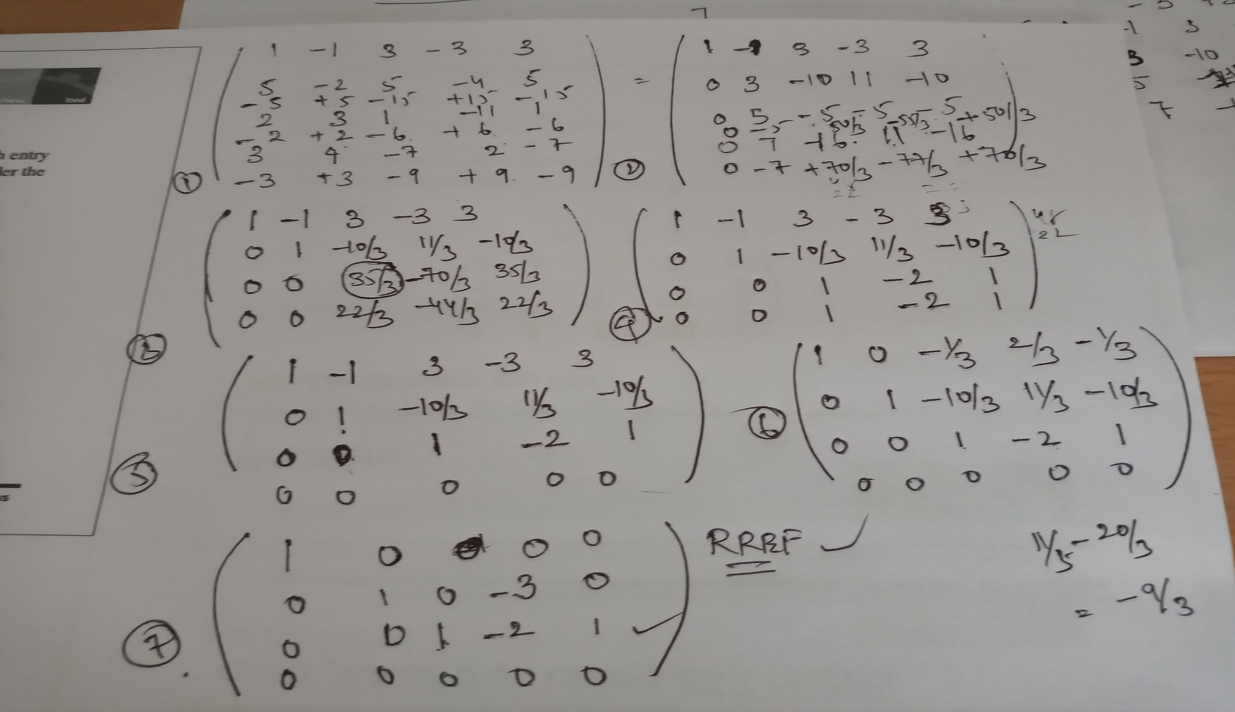
Solution:

Slide 31
Next Lecture :
System of equations : Gauss Elimination method
Inverse : Gauss Jordan method.
Thanking you..

